Slide 1
Upwork Job Market Analysis & Recommedation System

Slide 2
Internship Details
Data science Internship project- 8(Nexthike)
Name – Shweta singh

Slide 3
Project Statement
Need to analyze job market trends and build a recommendation system

Slide 4
Project Objective
Analyze trend, salaries, countries and create an interactive dashboard using Stremlit

Slide 5
Dataset Overview
Dataset Columns
• title – Job title • link – Job posting URL • published_date – Date and time of posting • is_hourly – Hourly or fixed-price job • hourly_low – Minimum hourly rate • hourly_high – Maximum hourly rate • budget – Fixed-price project budget • country – Client country
244,828 Job Postings
Tools: Python • Pandas • Google Colab

Slide 6
Data Cleaning
Removed 1 record with a missing job title.
Replaced missing country values with “Unknown”.
Checked missing values in hourly rates and budget fields.
Kept missing hourly/budget values where appropriate because jobs can be either hourly or fixed-price.
Created a new feature: Average Hourly Rate.
Converted published_date into a date format for time-series analysis.
Standardized job titles by removing extra spaces and applying consistent capitalization.

Slide 7
Methodology
Data Collection
Load the Upwork job-posting dataset into Google Colab using Python and Pandas.
Data Cleaning & Preprocessing
Handle missing values, standardize job titles, process dates, and prepare relevant features.
Exploratory Data Analysis
Analyze hiring countries, job types, job titles, salary/rate patterns, and posting trends.
Data Visualization
Create charts to identify important patterns and trends in the job market.
Recommendation System
Filter jobs based on user-selected job role, country, and payment type.
Streamlit Dashboard
Present KPIs, visualizations, and recommended job postings with direct links.

Slide 8
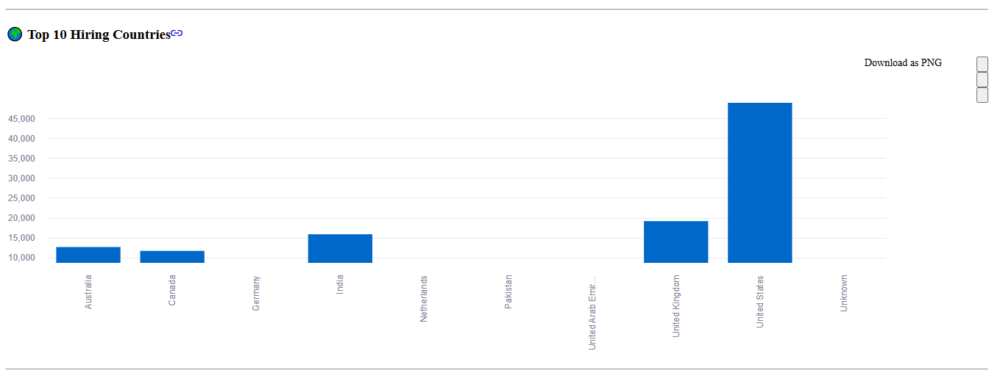
Top Hiring Countries
The United States is the dominant hiring market in the dataset, while the presence of multiple countries shows strong international demand for remote and freelance talent.
United Kingdom is the second-largest hiring market.

Slide 9
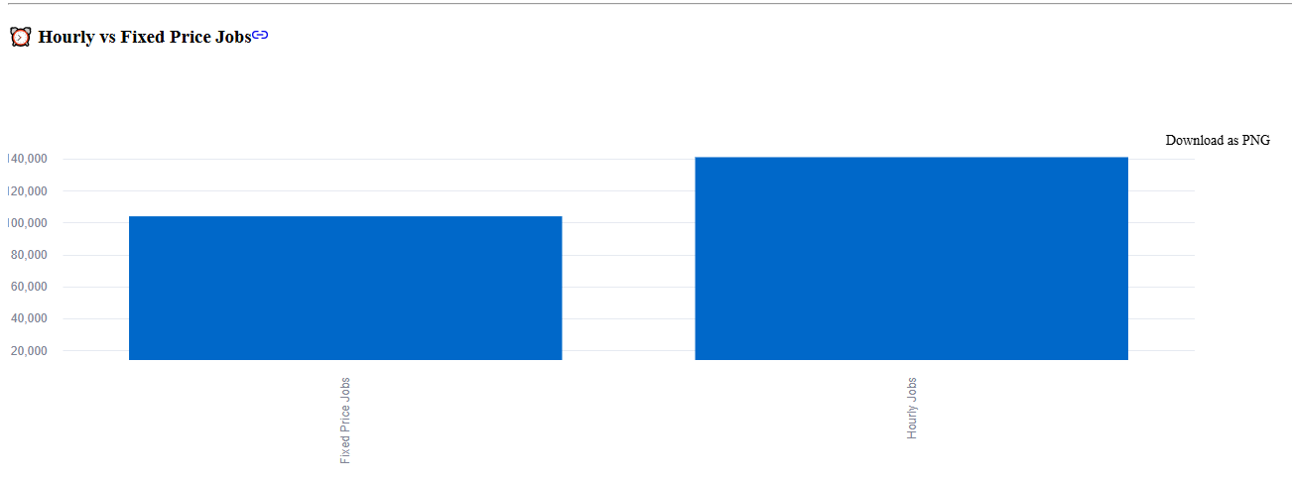
Hourly vs Fixed price Jobs
57.6% Hourly Jobs
42.4% Fixed-Price Jobs
Insight: Flexible hourly work is more prevalent in the dataset.

Slide 10
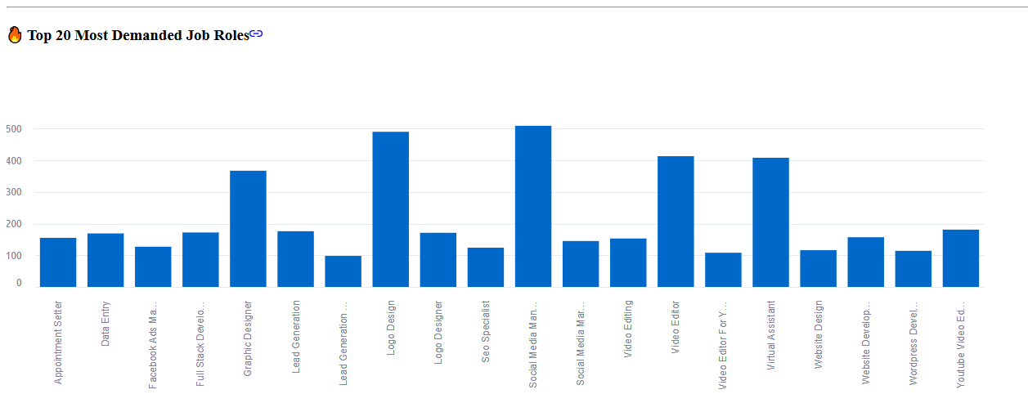
Most Demanded Job Roles
Social Media Manager is the most frequently posted role.
Creative services such as logo design, video editing, and graphic design show strong demand.
Virtual Assistant is another highly demanded remote role.
The results indicate strong demand for digital marketing, creative, and online support skills.

Slide 11
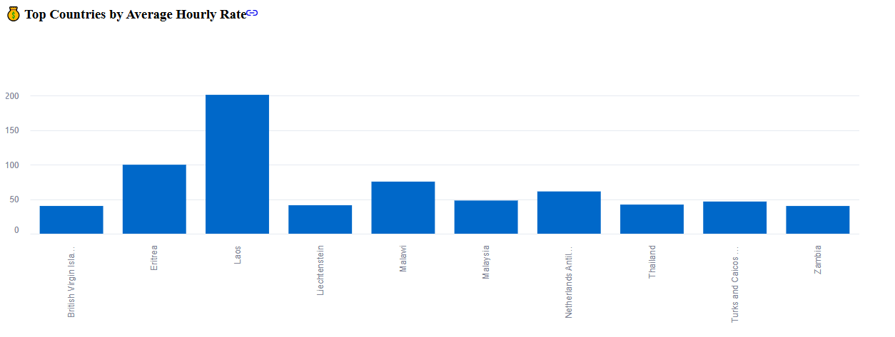
Salary Analysis by Country
Average hourly rates were calculated using the minimum and maximum hourly rates available for each job.
The analysis shows significant differences in average hourly rates across countries.
These differences may reflect variations in market demand, project type, skills, and hiring patterns.
The analysis can help freelancers identify potentially higher-paying markets.

Slide 12
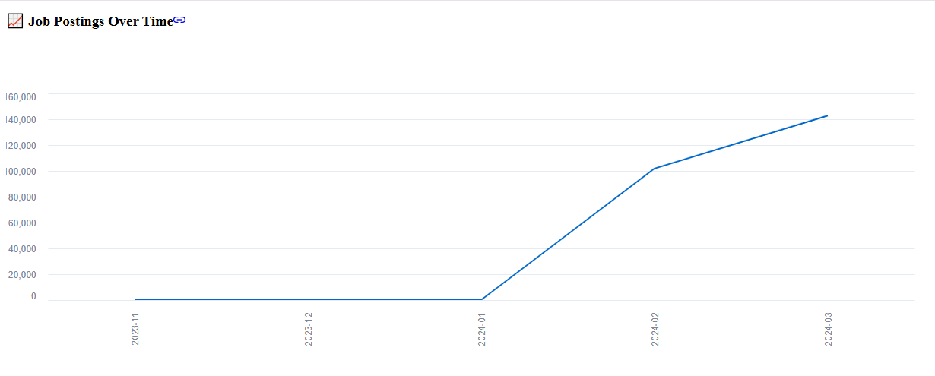
Monthly Job Postings Trend — 2024
The published_date column was converted into a date-time format.
Job postings were grouped by month to analyze hiring activity over time.
The dataset shows an upward trend in job postings from January to March 2024.
March 2024 recorded the highest posting activity in the analyzed period.
The trend suggests increasing demand for freelance and remote work during the observed period.

Slide 13
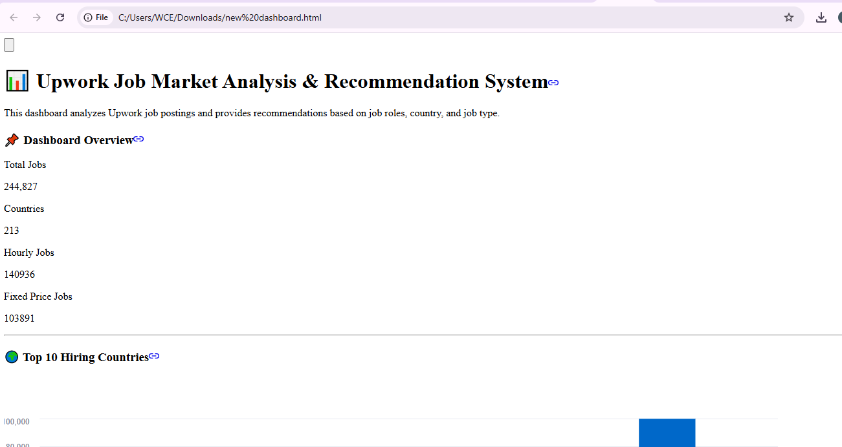
Streamlit Dashboard Overview
Main Features:
KPI Cards – Total Jobs, Countries, Hourly Jobs, and Fixed-Price Jobs
Hiring Market Analysis – Top hiring countries
Job Type Analysis – Hourly vs Fixed-Price opportunities
Salary Analysis – Average hourly rates by country
Time-Series Analysis – Job posting trends over time
Job Recommendation System – Search by role/skill and filter by country and payment type
Direct Job Links – Users can open the original job posting
Developed using Python, Pandas and Streamlit in Google Colab.

Slide 14
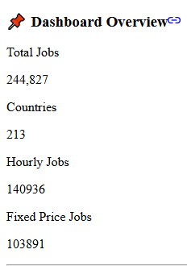
KPI Cards Dashboard
Purpose:
The KPI section enables users to understand the overall job market before exploring detailed charts and recommendations.

Slide 15
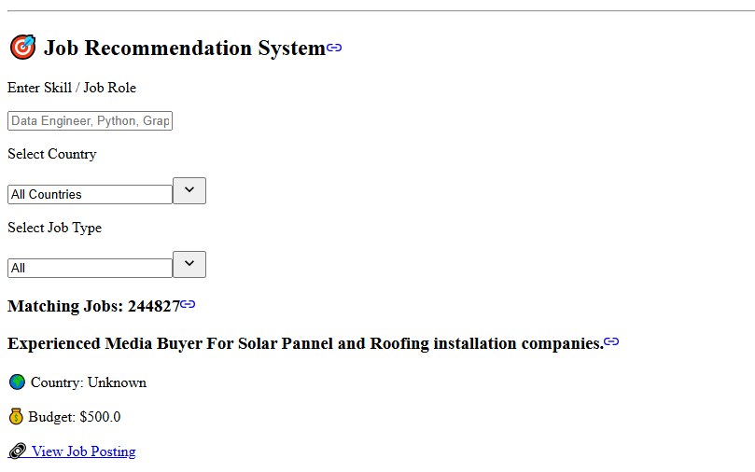
Job Recommendation System
How It Works:
Enter Job Role / Skill
Example: Data Engineer, Python, Video Editor
Select Country
Users can choose a specific country or view jobs from all countries.
Select Job Type
Hourly
Fixed Price
All
View Matching Jobs
Job title
Country
Hourly rate or project budget
Original job posting link
Input → Filter → Match Jobs → View Job Link

Slide 16
Technologies Used
Python and Pandas were used for data analysis, Matplotlib for visualization, and Streamlit for developing the interactive dashboard and recommendation system.

Slide 17
THANK YOU

